Slide 1

Reactive Ordering
trend monitoring
Robert Blacklidge | Springboard | August 1, 2016

Slide 2


The problem
Food product has a limited shelf life
Product ordering needs are difficult to judge
Meeting customer demand is the core of every business

Slide 3

Customer Sales
Machine learning helps meet customer demand

Slide 4





The Datasets
Weather
Stocks
Fuel prices
Sales History
Crime Rates

Slide 5

Data Wrangling
Key aspects affecting data wrangling
Data points used

Slide 6

Finding the answers
Linear regression
Correlation matrix

Slide 7
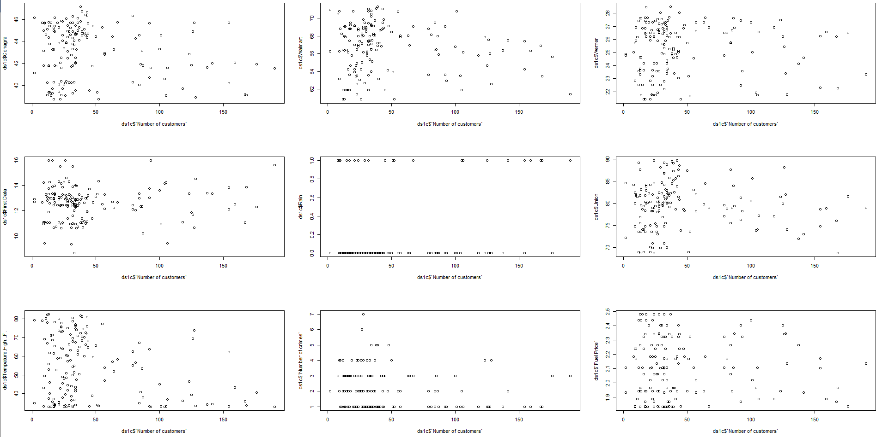
Plotting the data

Slide 8
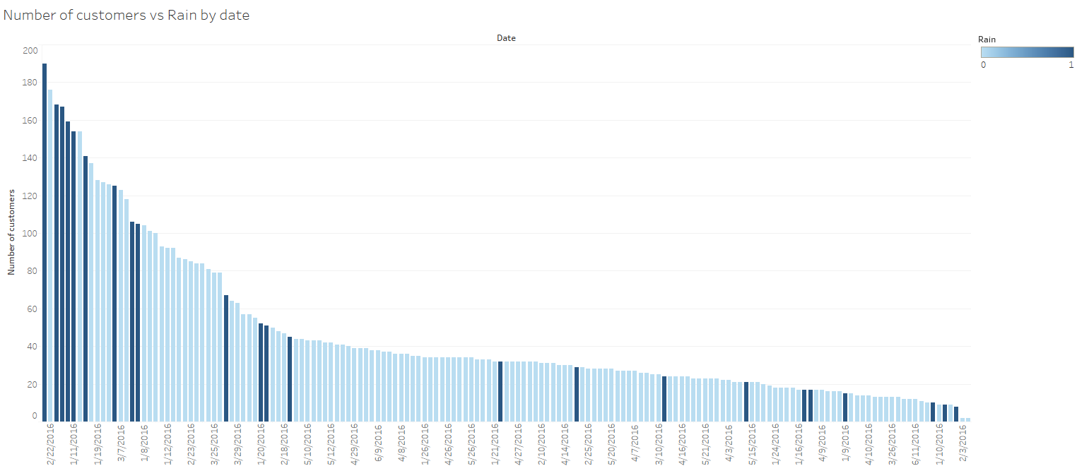
Recommendations
Graph shows high customer count on rain free days

Slide 9
Conclusion
After this exhaustive review of relevant data I have multiple recommendations for the restraint owner.
It is my express recommendation that the owner plan to support 46 customers each day. This number will maintain, allowing for your ordering to be equally level.
It is my express recommendation that the owner observe weather predictions for rain. On days without any rain there is a significant spike in customer count.

